Slide 1
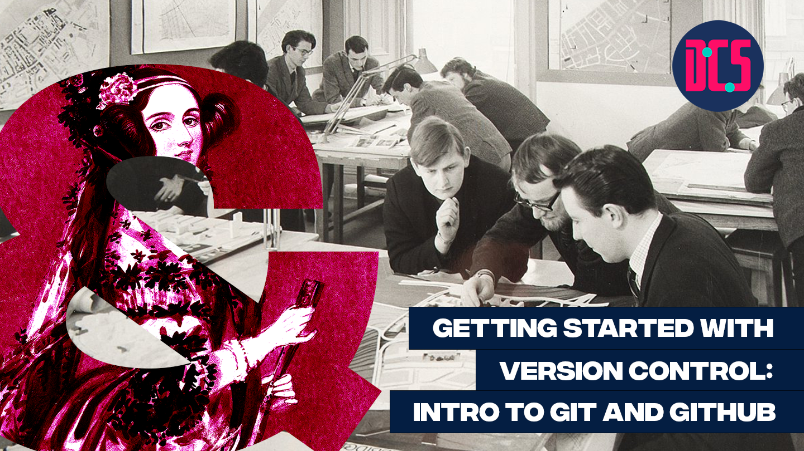

Slide 2

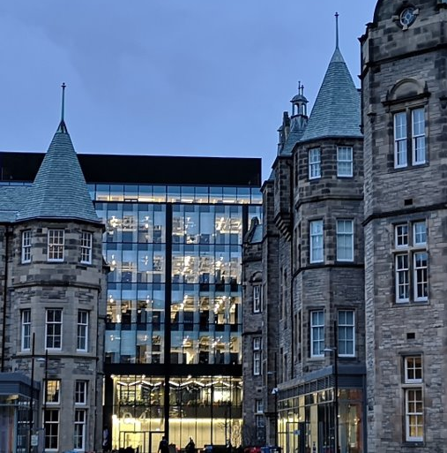

Support for data-led and applied digital research across the arts, humanities and social sciences.
Notes:
MT

Slide 3



Welcome!
Ponrawee Prasertsom
PhD student in Linguistics, PPLS
Joy Lan
PhD student in Digital Education, Moray House School of Education
Original materials developed by Aislinn Keogh
www.cdcs.ed.ac.uk

Slide 4
Plan for Today
10:30 Welcome & introduction
10:50 Live demo & troubleshooting: Create your first repo & your first commit
11:10 Live Demo & troubleshooting: Create a new branch and merge it
11:30 Break
11:40 Live Demo & troubleshooting: Fork a repo & create a pull request
12:00 Live Demo & troubleshooting: Resolving a merge conflict
12:20 Wrap up & additional resources
12:30 End of workshop
www.cdcs.ed.ac.uk

Slide 5
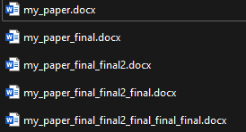
Version Control
Version control helps you track changes to your files.
You probably already have done (poor) version control before!
www.cdcs.ed.ac.uk

Slide 6
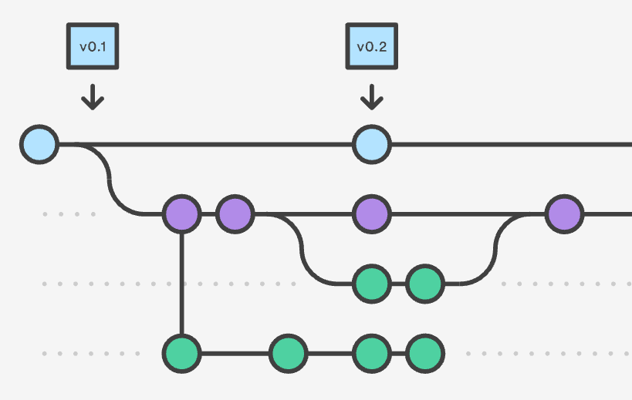
Version Control
Version control is the practice of tracking and managing changes to files (traditionally, software code).
Version control tracks every individual change by each contributor and helps prevent concurrent work from conflicting.
It is a standard workflow in the tech industry.
www.cdcs.ed.ac.uk

Slide 7
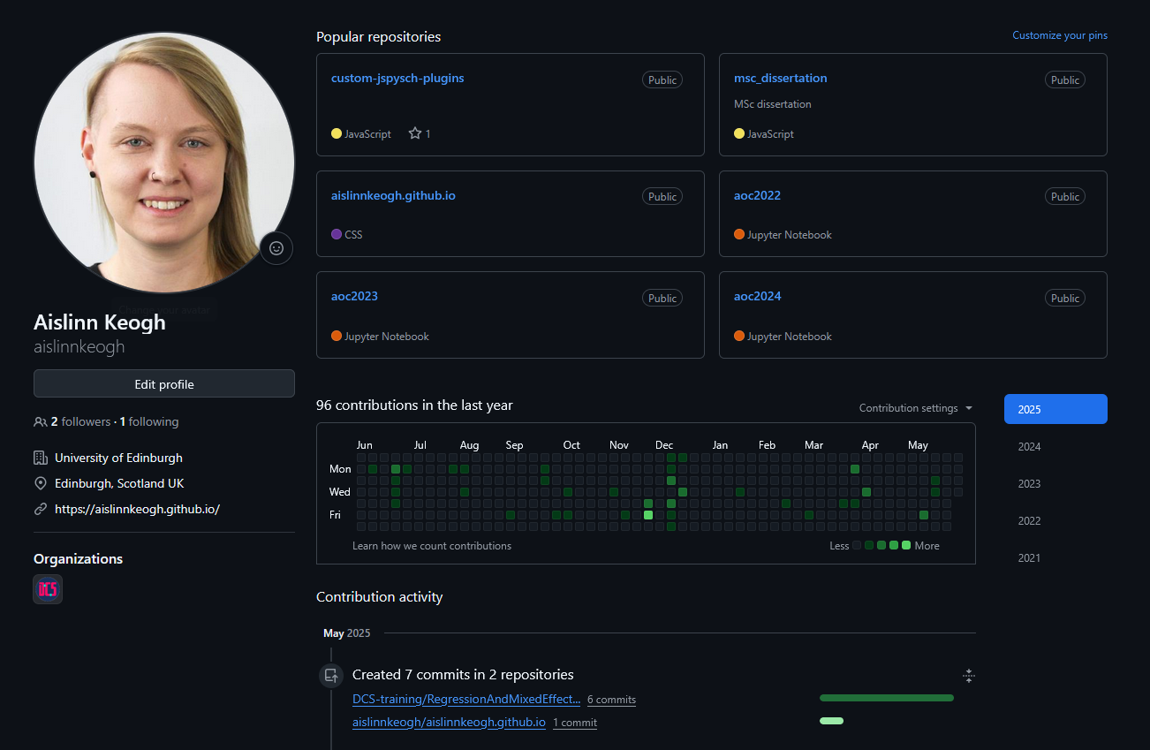
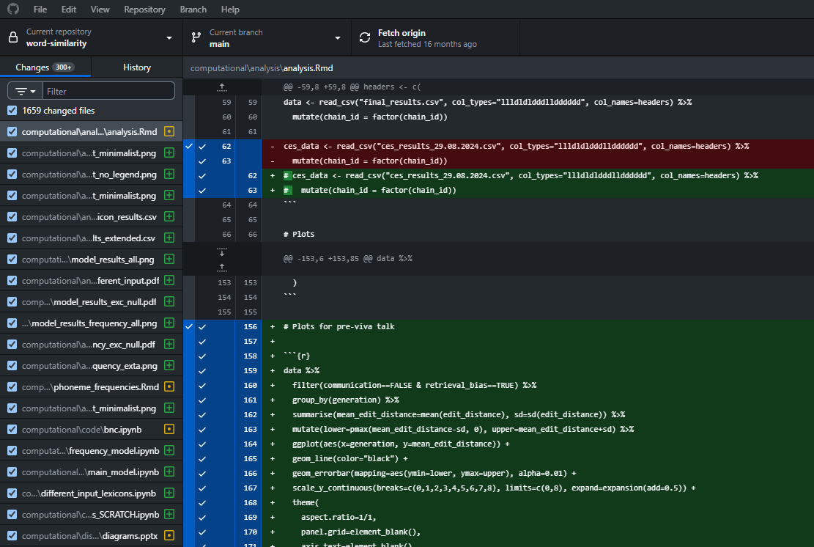
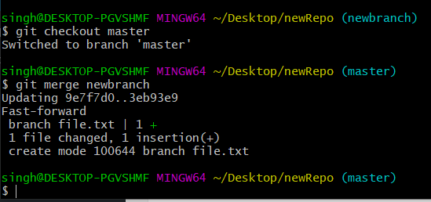
git | GitHub | GitHub Desktop
A distributed version control system | An online platform for collaborating on code, based on git | A desktop application for working with git and GitHub on your computer
No need to learn this for basic use cases!
Image from https://funkyvast.weebly.com/ what-is-git-bash-terminal.html
www.cdcs.ed.ac.uk

Slide 8
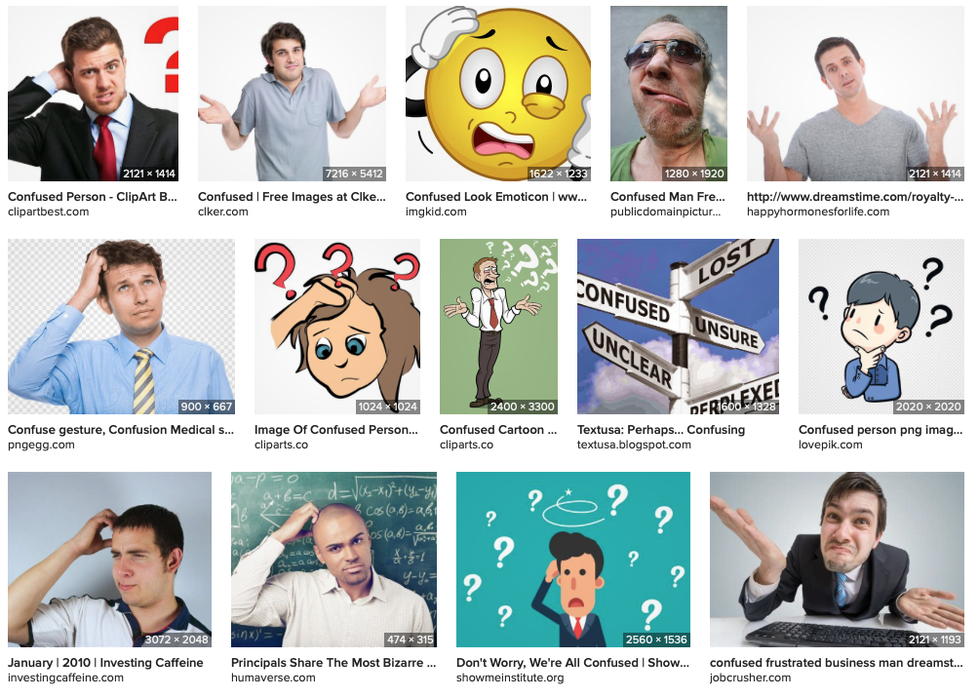
Terminology
repository/repo | → | a “folder” for your code for one project
commit | → | saving your changes in the project
clone | → | a copy of a repo (e.g., on your computer)
branch | → | a parallel version of a repo (repos can have multiple branches)
merge | → | combine the changes from one branch into another
fetch | → | getting the latest changes from the online repo
pull | → | integrating the latest changes into your clone of the repo
push | → | sending your changes (your commits) to the server
fork | → | a personal copy of someone else’s repo
www.cdcs.ed.ac.uk

Slide 9
Terminology
repository/repo | → | a “folder” for your code for one project
commit | → | saving your changes in the project
clone | → | a copy of a repo (e.g. on your computer)
branch | → | a parallel version of a repo (repos can have multiple branches)
merge | → | combine the changes from one branch into another
fetch | → | getting the latest changes from the online repo
pull | → | integrating the latest changes into your clone of the repo
push | → | sending your changes (your commits) to the server
fork | → | a personal copy of someone else’s repo
www.cdcs.ed.ac.uk

Slide 10
Live Demo: Creating your first repo
Go to www.github.com
Sign in / sign up
Click the + in the top right corner and select “New repository”
Choose a repository name, check “Add a README file”, and leave all other fields.
Click “Create repository”
www.cdcs.ed.ac.uk

Slide 11
Live Demo: Cloning your repo with GitHub Desktop
Install GitHub Desktop from https://desktop.github.com if you haven’t yet
On the GitHub page for your repo, click “Open in GitHub Desktop”
Choose where to clone your repo
Click fetch & admire your repo in GitHub Desktop
www.cdcs.ed.ac.uk

Slide 12
Live Demo: Making a commit
Open the README file in a text editor of your choice If you’re unsure: on Windows use Notepad; on Mac use TextEdit
Make some changes in your README file and save them
In GitHub Desktop, describe your commit and click commit when ready
Push to GitHub
www.cdcs.ed.ac.uk

Slide 13
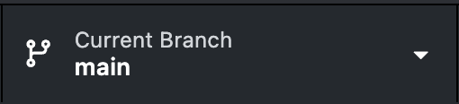
Live Demo: Creating a new branch and merging it
In Github Desktop, open the branch menu:
Select ‘new branch’ and enter a name of your choice. Confirm that this branch is now displayed under ‘Current Branch’.
Make some changes in your README file and save them as before, commit, then push.
Switch back to the main branch, click ‘Choose a branch to merge into main’ in the branch dropdown, select your new branch, and merge.
www.cdcs.ed.ac.uk

Slide 14
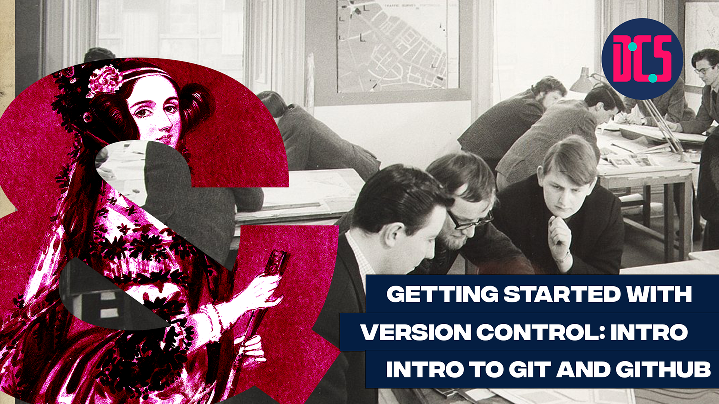
Break

Slide 15
Terminology
repository/repo | → | a “folder” for your code for one project
commit | → | saving your changes in the project
clone | → | a copy of a repo (e.g. on your computer)
branch | → | a parallel version of a repo (repos can have multiple branches)
merge | → | combine the changes from one branch into another
fetch | → | getting the latest changes from the online repo
pull | → | integrating the latest changes into your clone of the repo
push | → | sending your changes (your commits) to the server
fork | → | a personal copy of someone else’s repo
www.cdcs.ed.ac.uk

Slide 16
Live Demo: Forking a repo, making a commit, and making a pull request
Find a partner and get the link to their GitHub repo. Fork it on GitHub, then add your fork to GitHub Desktop.
Make a change to their README, commit, and push.
On GitHub, view your fork and open a pull request.
Review and approve each other’s pull requests.
www.cdcs.ed.ac.uk

Slide 17
Live Demo: Resolving a merge conflict
Choose either your partner’s or your repo.
To create a merge conflict: At the same time, both of you edit the title of the README, commit, and push.
The person who pushed second will get an error message about a merge conflict: resolve this as demonstrated.
www.cdcs.ed.ac.uk

Slide 18
Additional Resources
GitHub online tutorials
Introduction (tutorial repeating some of what we did today): https://github.com/skills/introduction-to-github
Reviewing pull requests: https://github.com/skills/review-pull-requests
Resolving merge conflicts: https://github.com/skills/resolve-merge-conflicts
List of all skills tutorials: https://github.com/skills
GitHub student pack: https://education.github.com/pack
www.cdcs.ed.ac.uk

